Slide 1



Student Information System
Module 8:
Student Record Maintenance & Changes
of Circumstance
Brought to you by the Number 5 and the Letter ‘J’

Slide 2
Introduction
Module 8 - Key Objectives:
  Understanding Programmes and Plans
  Understanding Data Changes
  Understanding Withdrawals
  Understanding Suspensions & Resumptions
  UPK Sessions

Slide 3
Programmes
Programmes are…
  …Well… Programmes
  There isn’t really anything special to say about them.
  Except to mention that SIS Programmes are very fond of…

Slide 4


Programmes
This is because in SIS, Programmes are very much like Umbrellas, ella, ella, eh, eh, eh (sorry!)

Slide 5
Plans
Plans are both…
  Award Aims e.g.
    BA (Hons)
    BA
    DipHE
    CertHE
  Route ways or Specialisms
    Adult Nursing
    Mental Health Nursing
    Child Nursing

Slide 6
Programmes & Plans
Nursing
Programme
BA (Hons)
BA
Child
Plans
Adult
CertHE
The Programme is the umbrella that holds the Plans together.

Slide 7
Programmes
Any Questions?

Slide 8
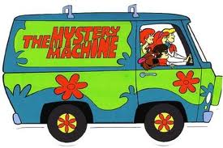
Programmes, Plans & Students
We have explored how SIS is built
But now we need to understand the Student Records themselves and how we interact with them
And this is where the ‘Mystery of the Programme/Plan Stack’ comes in...

Slide 9
Programme/Plan Stacks
Career Nbr 0
Career Nbr 1
Programme
Programme
Programme
Programme
Plan
(Award Aim or Routeway)
Plan
(Award Aim or Routeway)
Plan
(Award Aim or Routeway)
Plan
(Award Aim or Routeway)
Term Activation
Level
Modules
Modules
Modules
Modules
Fees

Slide 10
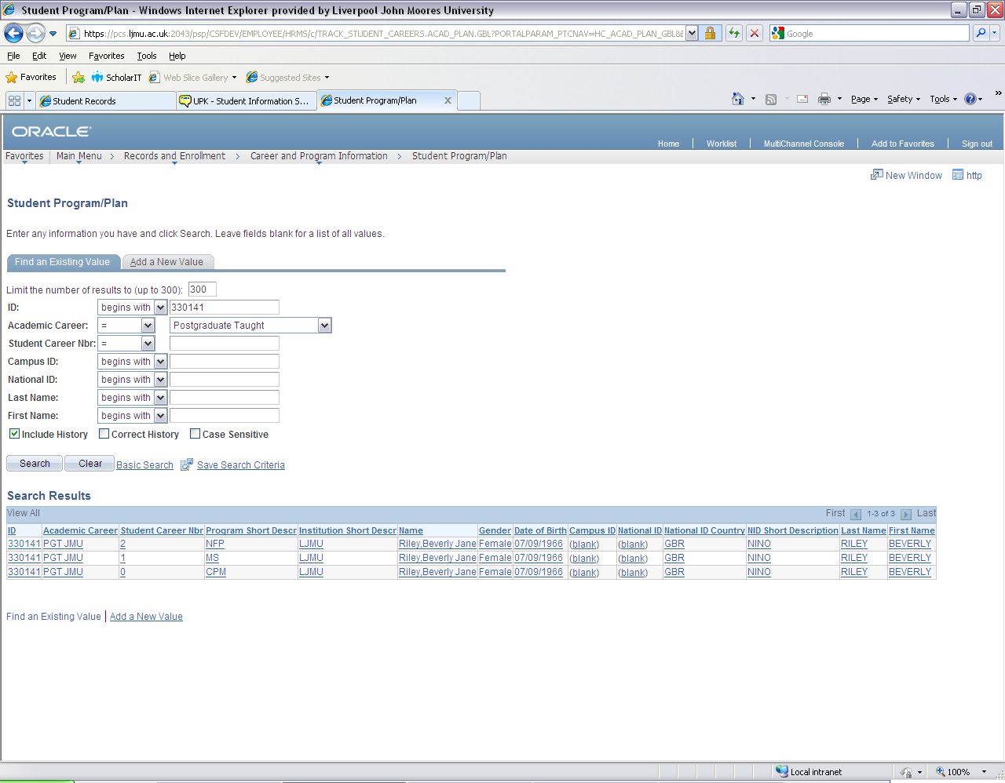
Programme/Plan Stacks
For Example:
This (real) student is currently studying on 3 different Programmes

Slide 11
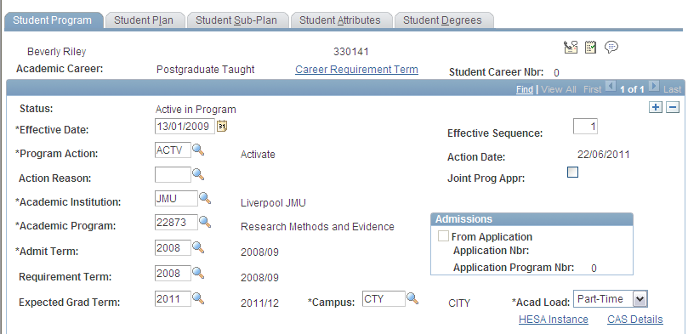
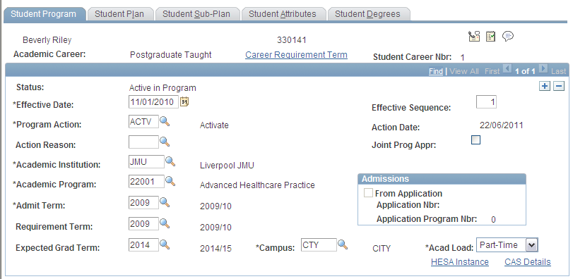

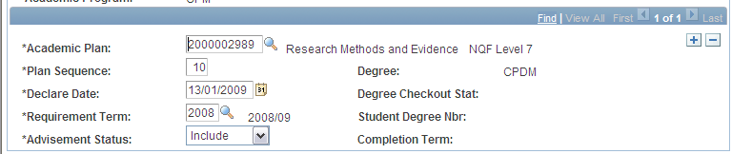


Programme/Plan Stacks

Slide 12
Programmes Actions
Programme Actions allow us to build up a history of activity on a Prog/Plan Stack
Some Programme Actions include:
DATA
DISC
LOA
ACTIVATE
RLOA
PLCN
PRGN
COMP

Slide 13
Programmes Actions
Of course History is meaningless unless there is an element of time

Slide 14
Effective Dates
Throughout SIS whenever an action is performed, the date the action happened (or is to happen) is recorded
This is an Effective Date

Slide 15
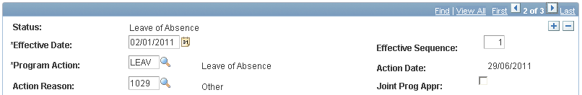
Effective Dates
For each action that is recorded, a new Effected Dated Row is added to the Prog/Plan Stack
For Example, we can see when this student went onto Leave of Absence

Slide 16
Programme/Plan Stacks
So, using a combination of Programme Actions and Effective dates we can understand the story of a students period of study.

Slide 17
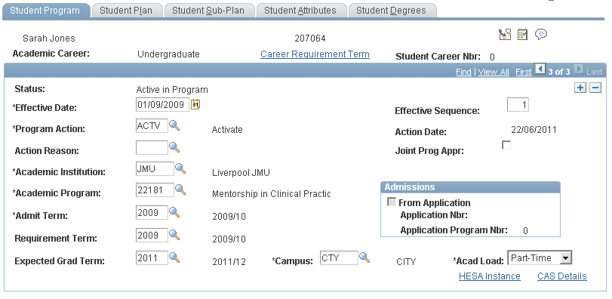
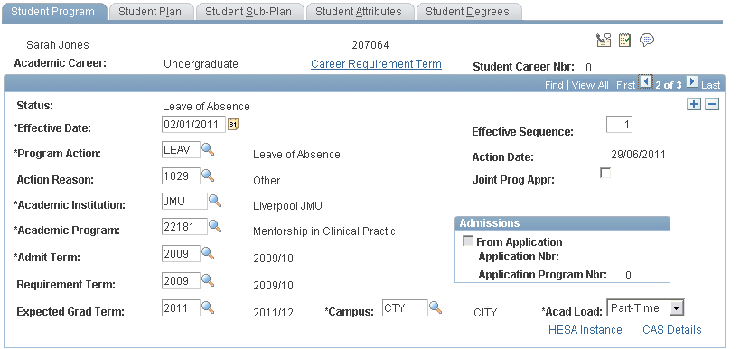
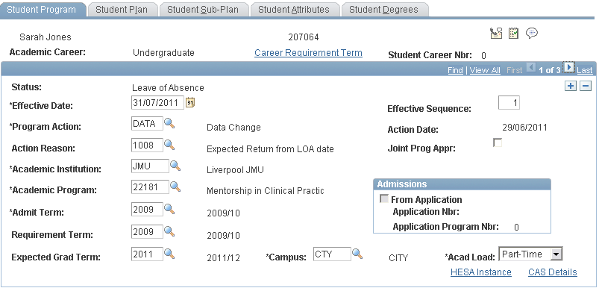
Programme/Plan Stacks

Slide 18
Student Records
In summary all the process today involve the Prog/Plan Stack, Programme Actions and Effective Dates

Slide 19
Programme/Plan Changes
There are two types of Transfer possible in SIS
Plan Change. This allows transfers within the same Programme, so for example an Award Aim change or a change of Routeway.
Programme Change. This occurs when there is a complete change to a new programme of study.

Slide 20
Programme/Plan Changes
Programme/ Plan changes of any type are only to be completed at either:
The beginning of Term (before the Module Deadline date) or
At the End of Term.
No mid term changes are permissible.
However it is important to note that the process does change a little depending on when in the Term these changes are made.

Slide 21
Programme/Plan Changes
Key Principles
June/July – Programme/Plan Changes
The programme/plan change is performed on the student record with a future dated effective date (e.g. 01/08/2011).
Student is advised that the Programme/Plan Change will be active from the future dated row.
September – Programme/Plan Change
Programme/plan changes completed once a new Term has started should be entered with the actual date.
Student is advised that new Programme/plan is now active.

Slide 22
Programme/Plan Changes
Key Principles
The Programme/Plan changes above are relatively simple as at this time the students aren’t enrolled in any classes.
If a Prog/Plan change takes place when Classes ARE enrolled then the process is a little more complicated.
Withdraw the student from the Term – this drops the Classes and cancels the Fee
Add the prog/plan change to the Stack
Re-activate the student onto the Term
Enrol the student on to the new Classes

Slide 23
Data Changes
There are occasions that we need to amend data the sits only on the Prog/Plan Stack e.g.
Expected Graduation Term
Requirement Term (used in Advisement)
Change in Academic Load (FT, PT, SW...)
All we need to do is Add a new Effective Dated row with an action of ‘Data’ (data change).

Slide 24
Responsibility Matrix
Scenario | CS process | Responsibility | Notes
Foundation program at JMU to ANY undergraduate program at JMU | Programme Change | Student Zone
Degree programme to ANY degree program | Programme Change | Student Zone
HND in Subject Area X to Degree program in subject X | Programme Change | Student Zone
HND to 2nd Year of degree (and vice versa) | Programme Change | Student Zone | Please see additional notes below ²
Foundation Degree or other programme at Partner Institution to degree at LJMU, if the marks are counting towards the degree classification. | Programme Change | Student Zone
Student transfer from joint honours programme to single or major/minor route | Programme Change | Student Zone | Please see additional notes below ³
Foundation course with NUFC award – (no need to complete) | Programme Change | Student Zone
FT to PT on different programme codes | Programme Change | Student Zone | Check with Andrew if these are multi-plan programmes
Mphil to Phd | Plan Change | Faculty
Award Aim and or Routeway | Plan Change | Faculty
New ‘multi programme’ | Plan Change | Faculty
FT to Sandwich or Sandwich to FT | Plan Change | Faculty
Foundation program at partner institution to ANY degree at JMU | Re-admission | Admission Hub & Student Zone
HND in Subject Area X to degree program in subject other than X | Re-admission | Admission Hub & Student Zone
Degree to Masters | Re-admission | Admission Hub & Student Zone
Masters to Mphil/Phd | Re-admission | Admission Hub, Research Office & Student Zone | ?
UG Architecture Students returning to do a placement year as part of a Post Grad qualification | Re-admission | Admission Hub
Level X to level 1 | Re-admission | Admission Hub & Student Zone | Please see additional notes below ¹
FT to PT on same programme code | Data Change | Faculty

Slide 25
Student Information System
Any Questions?
Let’s try the Programme/Plan Changes and
Data Changes UPK’s

Slide 26
Withdrawals
Combines
Prog/Plan Stack actions
with
Student Finance processes

Slide 27
Withdrawals
3 stage process –
Withdraw the student from the Term
Amend the Fees
Withdraw the student from the Programme

Slide 28
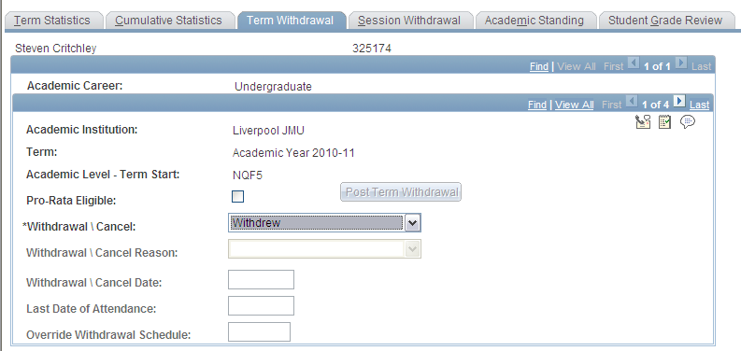
Term Withdrawal

Slide 29
Fee Amendments
Over to Kelly…

Slide 30

Withdrawals
TAG! You’re it Kel!

Slide 31
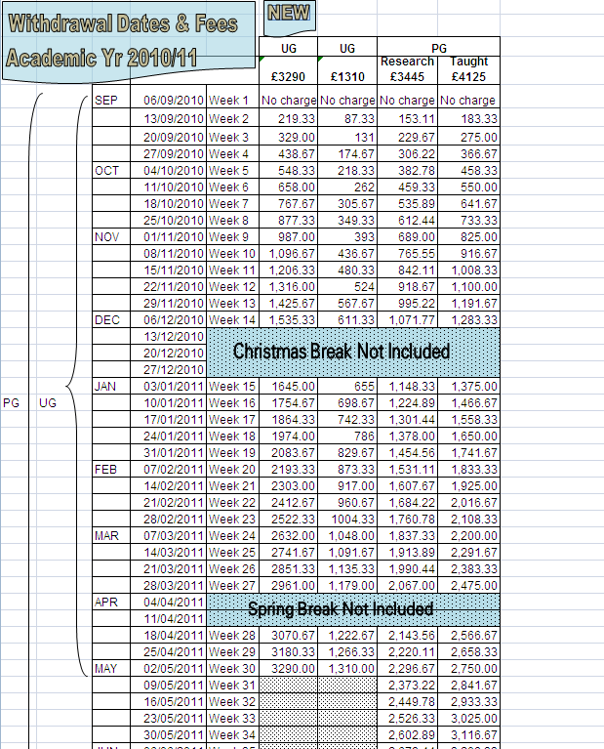
Withdrawal Fee Calculation
Student Withdrawals
Pro-rata calculations

Slide 32
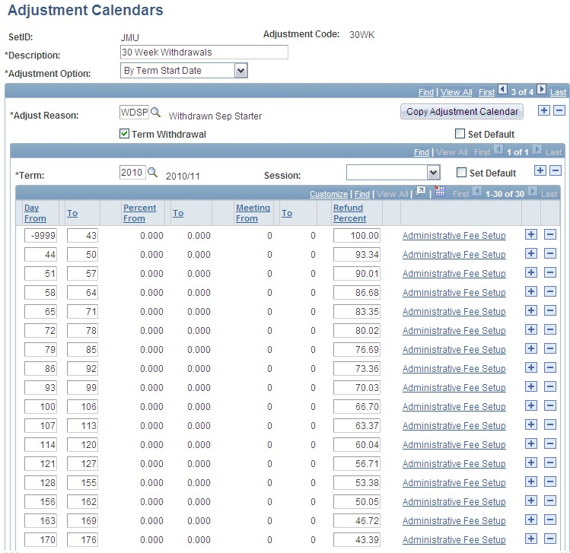
Withdrawal Fee Calculation
Student Withdrawals
Pro-rata calculations
Set up for
30 Week UG
45 Week PGT PGR
15 Week CPD
Island 1/3 Fees
No Refund after week 1
ADMIN
Writing UP
September starters
January starters

Slide 33
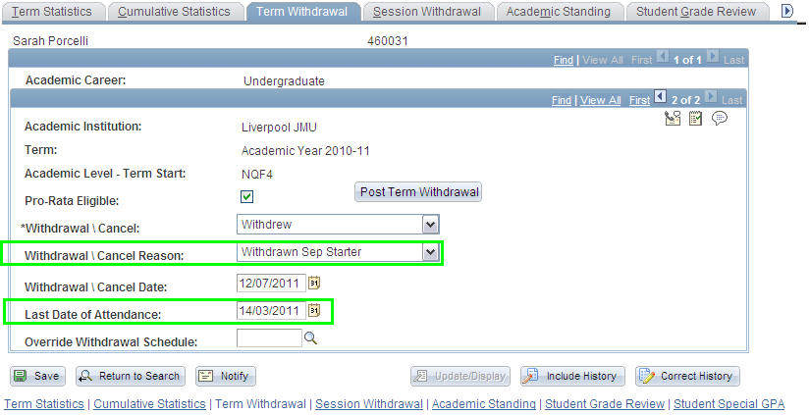
Withdrawal Fee Calculation
Term Withdrawal

Slide 34
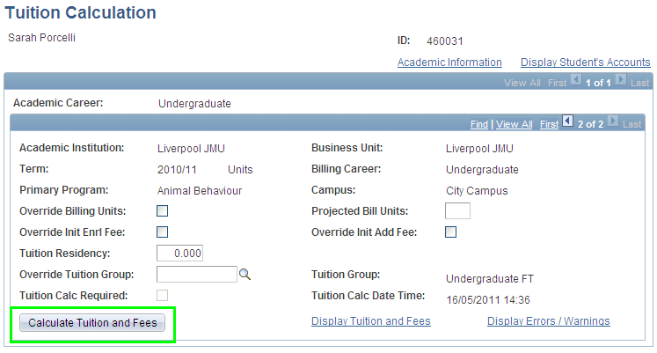
Withdrawal Fee Calculation

Slide 35
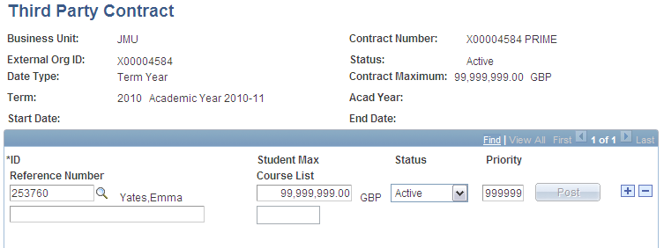
Withdrawals & Sponsors
Withdrawals & Sponsors
Good News! Sponsors (Third Party Contracts) will automatically re-adjust to the withdrawal fee.

Slide 36
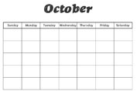

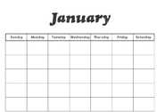

Withdrawals and SLC
Withdrawals & SLC Funding
SLC sponsored students who withdraw before December 1st are liable for tuition fees (no tuition fee loan or grant allowed)
SLC sponsored students who withdraw after December 1st are entitled to use their tuition fee loan to cover the balance due

Slide 37
Withdrawals and SLC
Withdrawing before December 1st
Withdrawal takes place on SIS & re-calculation of fee occurs
Details uploaded to SLC portal to inform them of student withdrawal and fee charged to student
SLC will do a re-assessment which will then show the student as owing the fee due. This will then be imported into SIS.
There may be a delay with the SLC processing the re-assessment but we will need to re-bill the student ASAP.
Please therefore email Helpdesk Mail and we can cancel the tuition fee loan to reflect this.

Slide 38
Withdrawals and SLC
Withdrawing after December 1st
This should not be a problem as the student is not likely to be in debt. Therefore we will wait for the re-assessment to come through

Slide 39
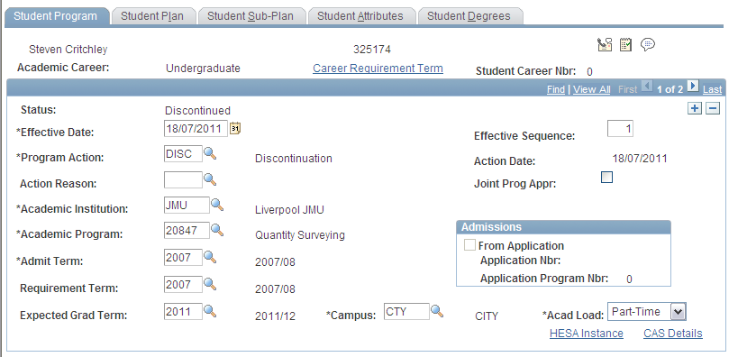
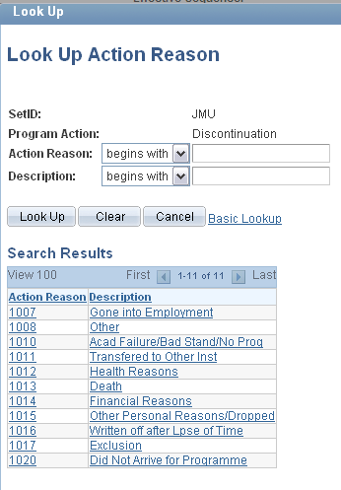
Withdrawal from Programme

Slide 40

Withdrawals
Once saved a Discontinued status CANNOT be undone.
It SHOULDN’T be done from a business process
But in addition, it actually CAN’T be undone, unpicked, amended or overwritten
If in doubt suspend the student and seek further information

Slide 41
Withdrawals
Any Questions?
Time for the Withdrawal UPK

Slide 42
Leave of Absence
Also known as Intermissions
Like Withdrawals we combine Prog/Plan actions with Student Finance
Record both a Leave action and date
and an Expected Return Date (a future dated row)
TAG

Slide 43
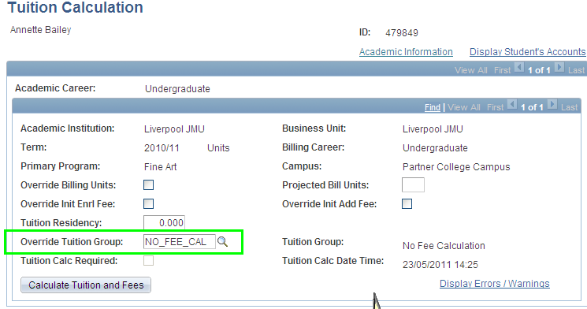

Suspensions (Finance)
Suspensions do not work like Withdrawals (unfortunately - no automatic calculation)
Therefore we have to work out the fee and manually raise it in SIS
Work out the suspension Fee due
Override the Tuition Group with NO_FEE_CAL

Slide 44
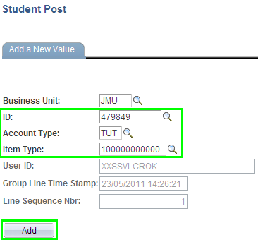
Suspensions (Finance)
Main Menu > Student Financials > Charges & Payments > Post Student Transaction
Student No
Choose TUT (Tuition)
Choose 100000000000 Suspension Fee

Slide 45
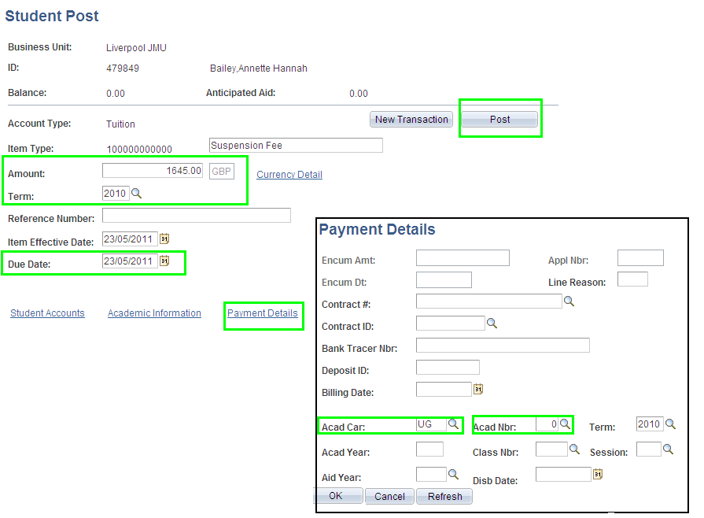
Suspensions (Finance)

Slide 46
Leave of Absence
Any Questions?
Let’s crack on.

Slide 47
Return from Leave of Absence
Another Stack/Finance combo
Record the action and the date the student actually physically returns to study
and crucially...

Slide 48
Return from Leave of Absence
The student needs to:
Complete the Student Registration Form
Be enrolled on to their Core classes and select/ enrol on their Options
This generates the Fee.
TAG

Slide 49
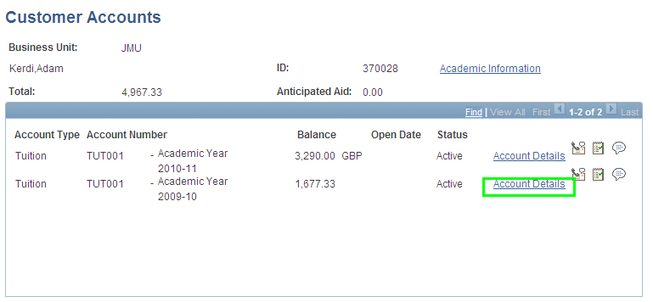
Resumptions (Finance)
When a student resumes study:
New Fee is generated
Subtract this fee from new fee

Slide 50
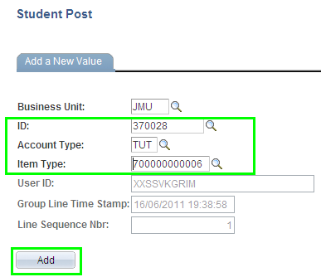
Resumptions (Finance)
Main Menu > Student Financials > Charges & Payments > Post Student Transaction
Enter Student No
Choose TUT (Tuition)
Choose 700000000006 Suspension
credit

Slide 51
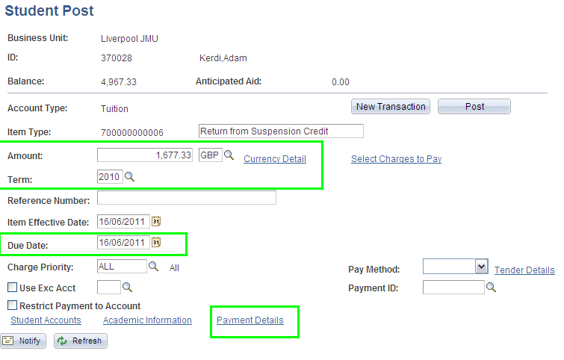
Resumptions (Finance)
In Amount enter the amount to be credited from this year’s tuition fee (1677.33)
In Term enter the current term (the year the student has ‘returned’)
Enter the Due Date as today’s date
Click on the Payment Details link, in the acad car/prog field select the correct program to credit

Slide 52
Leave of Absence
Any Questions?
Let’s try the last 2 UPKs

Slide 53
Student Information System
    Today you have found out…
How to action a Programme Change
How to add a Data row
How to process a Withdrawal
How to process a Withdrawal when a student is active on two programmes
How to process a Leave of Absence
How to process a Return from Leave of Absence

