Slide 1


Student Wellbeing and Success at OUC
Rafid Alkhaddar
Dean of Academic Affairs
Binoy Sobnack
Associate Dean for Student Wellbeing and Success

Slide 2
Introduction

Slide 3

Application
18, August, 2018
Initial Approval
16/06/2019
With conditions
Launch
January 2020
Intake 1
April 2020
COVID19
10 Students for MScPM
Feasibility Study
05, April, 2019
Clarification provided on 19/05/2019
MoEHE team visit on 15/05/2019
Intake 2
September 2020
127 Students
Intake 3
January 2021
Intake 4
September 2021
Intake 5
January 2022

Slide 4

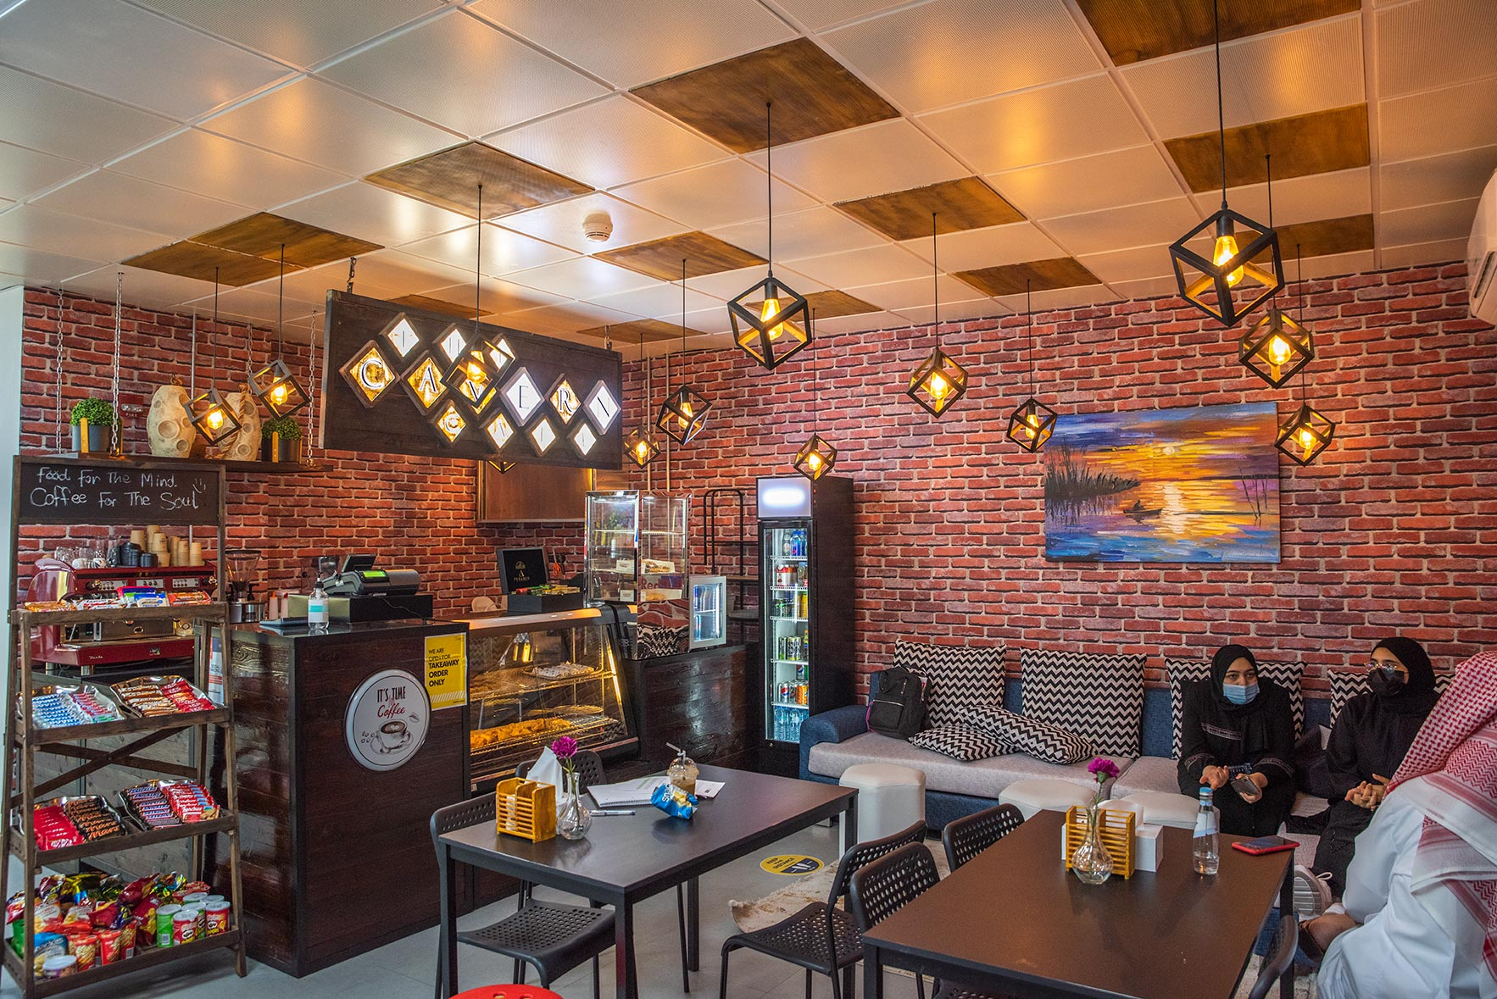

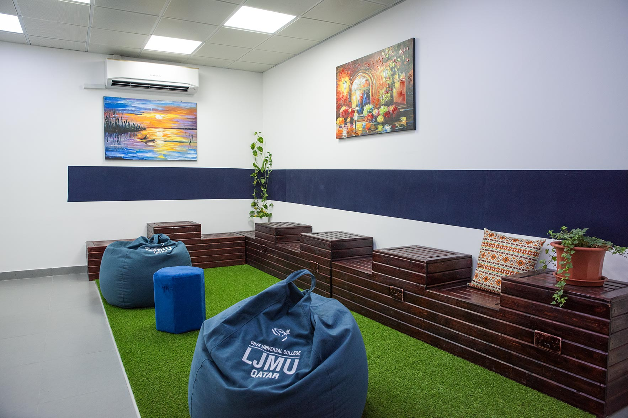
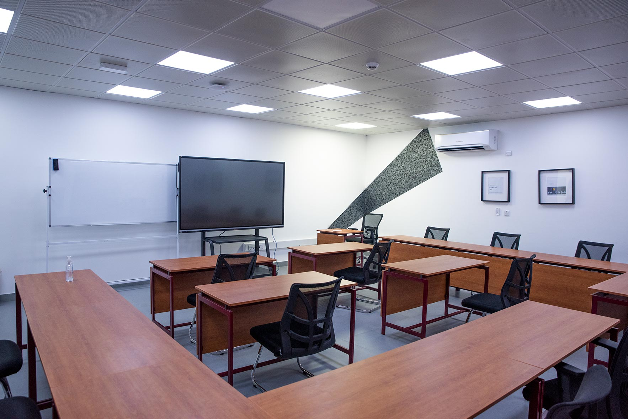
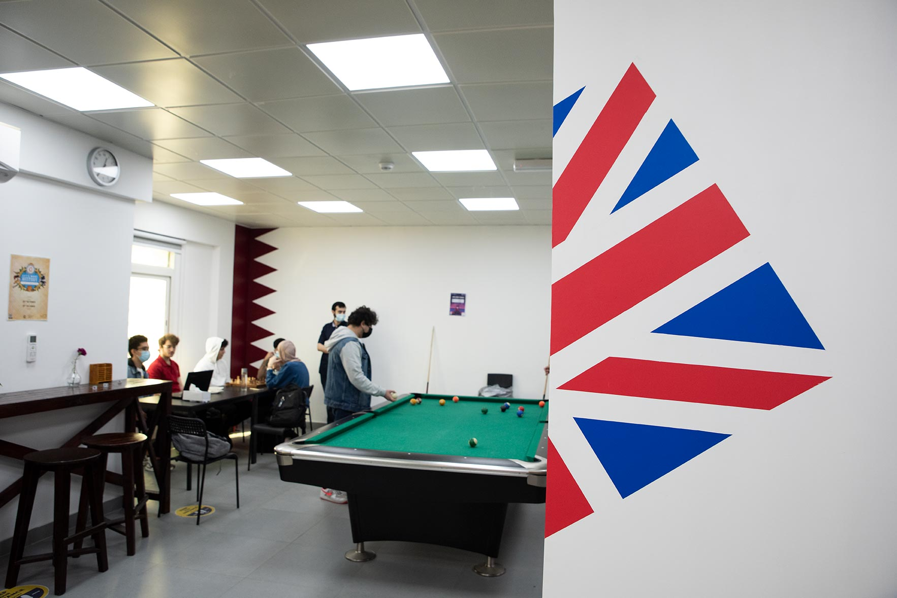

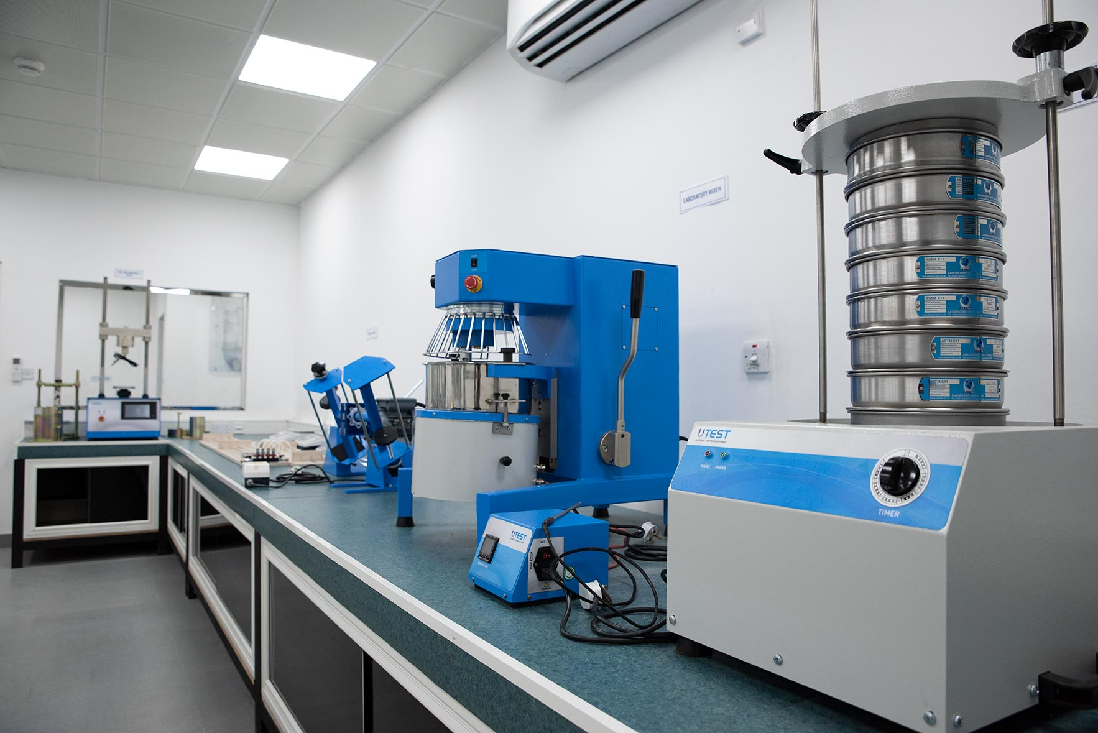
OUC Campus today…
Café
Library
Lobby
Classroom
Student Entertainment Area
Auditorium
Civil Engineering Lab

Slide 5
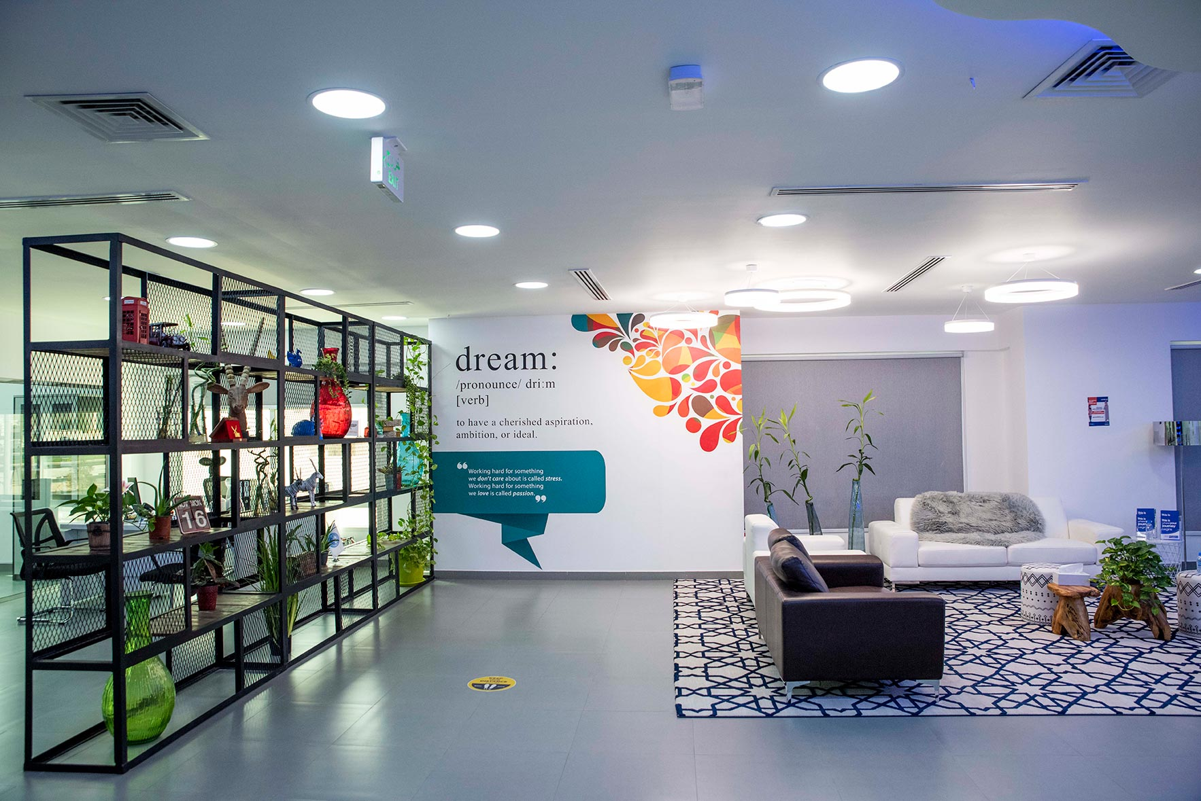

….Learn & Achieve!

Slide 6
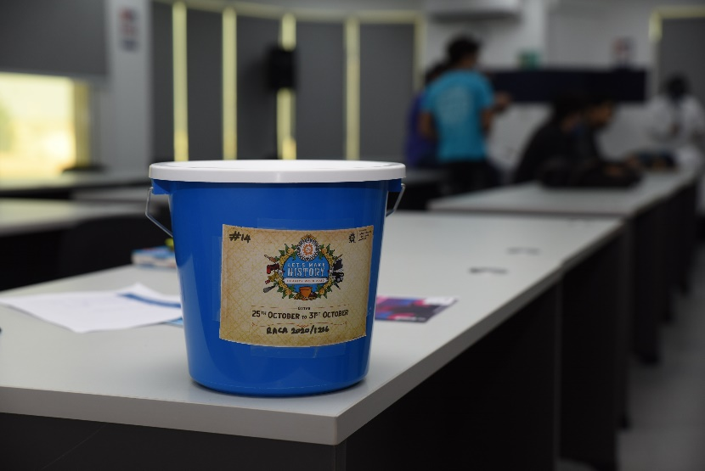
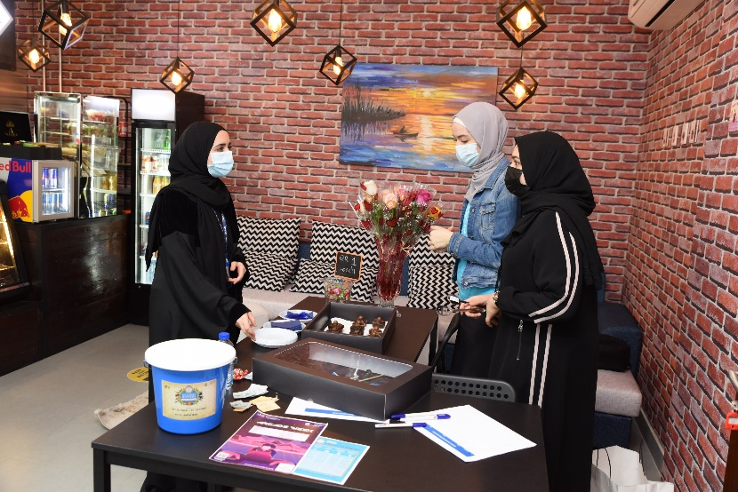
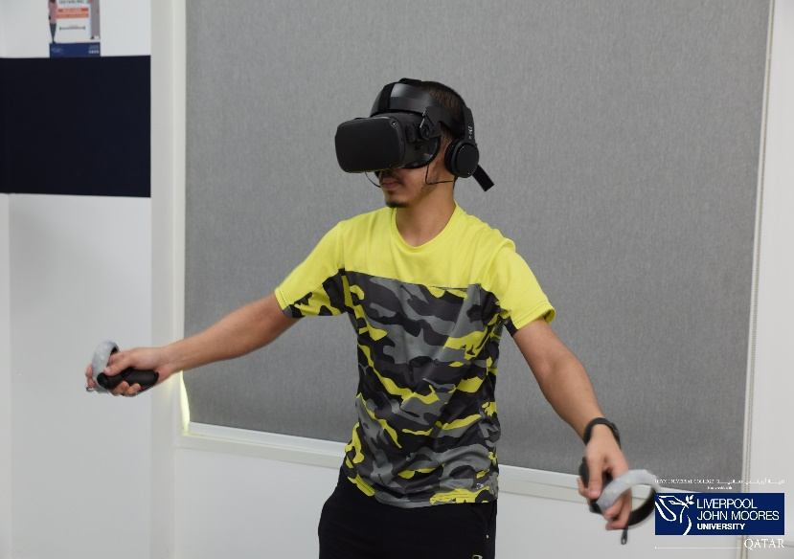


Students’ Life @
2020 – 2021
Int. Charity Week Event
Breast Cancer Awareness & Fundraising
VR Video Gaming Competition
Kayaking Trip
Excursion

Slide 7

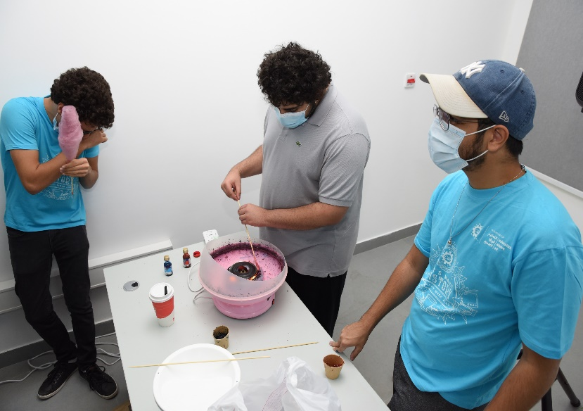
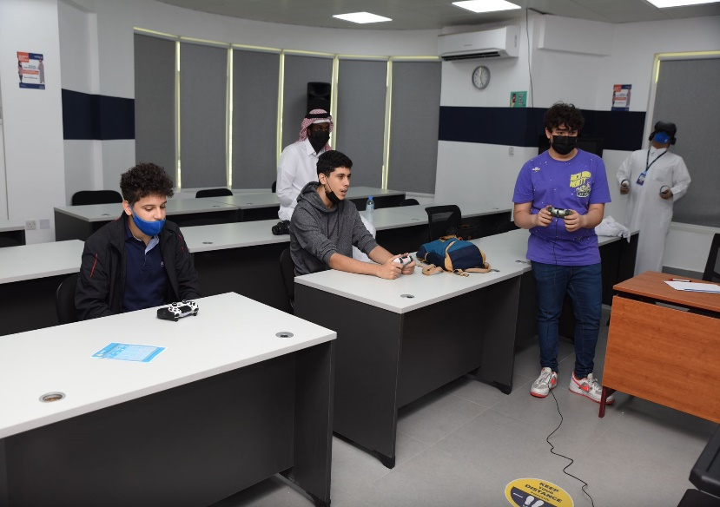
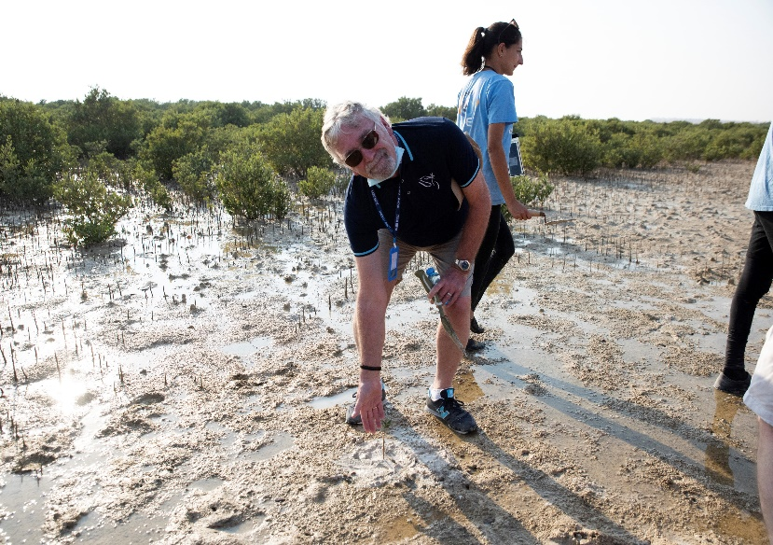
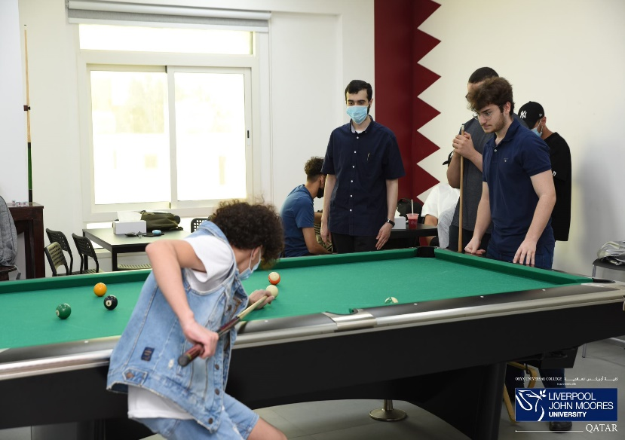
Students’ Life Experience
2020 – 2021
Sustainability @ the Sand Dunes
Fundraising for a good cause
Video Games Tournaments
Environmental Trip (Planting)
Indoor Entertainments

Slide 8
Marketing
2020
2021
Recruitment focus
Branding/awareness + Recruitment
2327 Leads – 192 students (paid deposit) – 8.25% conversion
Everyone in Qatar should know that we exist as an option
2327 Leads – 137 students (commenced studies) – 6.31% conversion
Generate 4,000 leads with 5% conversion
→250 Student
Generated revenue – 9m
Earned Revenue 8.9m
Projected Revenue to be generated -15m
Projected Revenue to be earned 13m
Marketing Budget – QR. 180,000
Marketing Budget – QR.800,000

Slide 9
Programs
2020
2021
Undergraduate
Civil Engineering
Computer Science
Quantity Surveying
Undergraduate
Civil Engineering
Computer Science
Quantity Surveying
Mechanical Engineering
Human Resources Management
Postgraduate
Postgraduate
MSc in Project Management
MSc in Project Management
MSc in Leadership and Management Practice
PGD in Education
MSc in Investment and Finance
MSc in Cyber Security

Slide 10
Student Success: Six success factors
  Directed Students have a goal and know how to achieve it
  Focused Students stay on track—keeping their eyes on the prize
  Nurtured Students feel somebody wants, and helps, them to succeed
  Engaged Students actively participate in class and in extracurricular activities
  Connected Students feel like they are part of the university community
  Valued Students’ skills, talents, abilities and experiences are recognised; they have opportunities to contribute and feel their contributions are appreciated

Slide 11
10 Ways in which we help can support Student Success
What the student experiences… advice and support from various sources
What we see…
My tutor
who is
patient with
me
Student
Services
Lectures
The lecturer
who believes
in me
The nice lady
in the admin
office
Student
The man in
the café who
asks how I
am doing
The students
I study with

Slide 12
10 ways everyone can help students experience the “six success factors”
directed, focused, nurtured, engaged, connected and valued
  Ask students why they are at university (directed, focused, nurtured)
  Help students navigate their way through the different offices and services at the university (connected, directed, engaged)
  Connect students with services or resources that can help them with career exploration, goal selection and ongoing academic assistance (directed, engaged, connected)
  Have high expectations for students and hold them accountable (focused, nurtured)
  Ask students for feedback about their experience, including what works, what needs
  improvement and what’s missing (engaged, valued)

Slide 13
10 ways everyone can help students experience the “six success factors”
Focused, directed, nurtured, engaged, connected and valued
  Encourage participation in out-of-class activities (engaged)
  Help students build peer support networks (connected, valued)
  Show students that we are proud to work at our institution and that they should be proud to be at our university (connected)
  Recognise the value of students’ talents, abilities, skills and experiences and connect them with opportunities to contribute (valued)
  Communicate and demonstrate to students that we care about their success (nurtured, valued)

Slide 14
Student Wellbeing and Success at OUC
One of the aims of OUC: one of the best providers of tertiary education in Qatar
Quality of education – NOT instruction
The best possible student experience
Take Student Wellbeing and Success seriously
Take tutoring to a level not seen at universities in the area

Slide 15
Student Wellbeing and Success at OUC
Taking Personal Tutoring very seriously
Approach to personal tutoring moving on from academic support towards pastoral care and support
Personal tutors transitioning “personal development tutors”
Setting up minimum standards for personal tutoring

Slide 16
Personal Tutoring
Varying levels of interaction between tutor and tutee
Minimum standards for personal tutoring + learn how to be an effective tutor
Tutoring needs to be both academic and pastoral
  Effective tutoring acknowledges the `whole student’, both their academic needs and their pastoral needs. Successful tutoring approaches recognise the importance of skilled interpersonal conversations that explore both academic and personal goals, as well as the reality that students currently face.
  Students from all year groups need tutoring

Slide 17
Know our limits
  Personal tutoring is also about referral: advise only within the limits of our expertise
  Important to listen to students, provide advice to the best of our ability and work alongside specialist support services to get students the support that they require. Active referral means facilitating a referral properly
Apply tutoring principles at all times
  The principles of effective tutoring apply to all teaching and learning contexts
  Building effective working tutee-tutor relationships based on trust takes time – so need to call on all the information that we see and hear in formal and informal settings
  Don’t limit tutoring to what we hear/see only during scheduled meetings

Slide 18
Tutoring is about being human
  Focus our attention on students and actively listen to what they have to say. Structure our approach around open questioning.
  Remember that students have different needs, backgrounds, motivations for learning and different pressures
Set boundaries
  Student-tutor boundaries are essential. An open conversation about how we can provide support can help to manage unrealistic expectations.
  Tutoring exists to help students become independent, but often they cannot do so without effective advice and guidance.

Slide 19
Personal Tutors should keep retrievable records, written or electronic, of all formal meetings with their students
  Accessible and should take current Data Protection legislation into account
  Good practice to keep written records on student files which are accessed via the academic in charge of personal tutoring (Senior Tutor in the UK)
Personal Tutors should be aware of procedures to be followed if students fail to attend scheduled meetings
  What efforts to make to contact the students?
  Who else to alert if a student is, for example, not responding to emails?

Slide 20
Student Wellbeing and Success at OUC
Workshops for all academic staff on personal tutoring
  What is effective personal tutoring?
  To identify the challenges in personal tutoring, and to help individuals appreciate good practice in terms of effectiveness and efficiency
  How to get the best out of one-to-one meetings
  To help personal tutors be more effective in one-to-one meetings with their tutees
  How to get the best out of group meetings
  To enable personal tutors to get the best out of group meetings using techniques to engage and promote shared experiential learning
  How to share good Personal Tutoring practice
  To equip PTs with techniques and skills to promote good PT practice among other colleagues within and beyond OUC

Slide 21
Student Wellbeing and Success at OUC
Moving personal tutoring under the broader umbrella “student wellbeing and success”
  Student health and student mental health
  Counselling
  Personal tutoring and pastoral care
Workshops on Student Mental Health
  Tuesday 22 February Brain Health is Mental Health: An introduction to the bioengineering behind mental health and mental illness
  Tuesday 01 March Student Mental Health: An introduction to common mental health concerns and a guide on how to address them

Slide 22
Student Wellbeing and Success at OUC
Student-staff Liaison Committee (SSLC)
  OUC will develop a model for the SSLC (in line with the Code of Practice) that works well for the College, encourages open and positive dialogue between students and staff and seeks to achieve timely positive change for students.
  Objective to ensure that every student feels their feedback is valued and can impact their education in a positive way – every student’s voice should be heard and effectively represented.
  A platform where students and staff meet for discussion and consultation about the students’ Course/Programme of study and other matters relevant to the quality of students' experience.
  SSLC committee meetings to be held twice per semester, with the frequency reduced to once per semester as OUC grows into departments, each of which can have their own SSLCs. Students NEVER to be outnumbered at SSLC meetings.
  SSLC meetings co-chaired by the the associate dean for student wellbeing and success and the OUC Student President (who is responsible for coordinating the Course Reps). The Student President is given the co-chair responsibility to clearly demonstrate that the representation process is a partnership between students and staff.
PEER Support Scheme
  Peer Mentoring Develop a PEER Mentor Scheme: fresher students are allocated a student Mentor from the same course. The Mentor is a friendly contact to support with the transition to Higher Education.
  Peer Assisted Learning (PAL) provides optional study sessions attached to a specific module or subject. Sessions are facilitated by students who have already passed the module and/or year.

