Slide 1
An introduction to self-help Library and study skills resources
Paul Chin - Head of Academic Services P.A.Chin@ljmu.ac.uk
Carolyn Benny - Academic Liaison Librarian C.M.Benny@ljmu.ac.uk

Slide 2
Today’s webinar…
Introduction
Introduction to e-resources
Study skills resources
Questions and answers

Slide 3
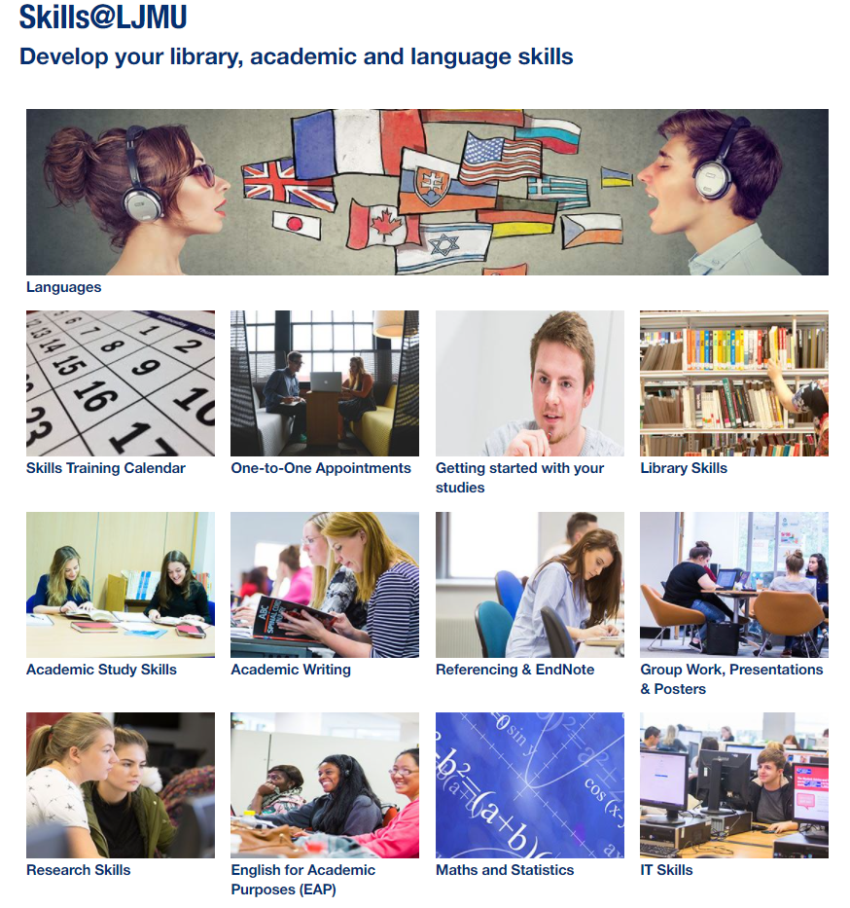

Slide 4
Introduction to e-resources
Library Skills
Introduction to Search Skills
Discover – Open Access
Google Scholar
Evaluation
Referencing
Reference Management
  Mendeley
  Zotero

Slide 5
Study skills resources
Academic writing
Academic study skills
Presentations
English for Academic Purposes (EAP)
Rosetta Stone

