Slide 1
Interacting with LJMU Systems
An overview of the LJMU systems that can be used by both staff & students

Slide 2
Your facilitator
Carl Denny c.a.denny@ljmu.ac.uk
Business Support Manager
Student Systems Development and Support
Student Information System, CRM (Microsoft Dynamics), Web hub, eDoc (PGR)
Efficiencies and Improvements
Started at LJMU in December 2003

Slide 3
Resources
APIS-BST@ljmu.ac.uk
https://www.ljmu.ac.uk/academic-registry/staff/academic-planning-and-information-services
https://www.ljmu.ac.uk/academic-registry/collaborative-partners/advice-and-guidance
https://www.ljmu.ac.uk/academic-registry/collaborative-partners/students

Slide 4
Staff
Request process
File parser
Web hub – collaborative area
My Results – staff view of student results
Gradebook templates
Other
Canvas – (Turn-It-In)

Slide 5
Access Request

Slide 6
Outputs

Slide 7
File Parser, Gradebook Templates
File parser – this is completed by the partner and loaded by Academic Registry to create the Student Record and associated resources

Slide 8
Web hub
The Web Hub acts as a powerful user friendly reporting tool as well as the institutions Business Intelligence system giving an all in one solution. The Web hub is a web based facility providing 24 hour access to data relating to Programs, Plans, Modules, Students, and much more. To navigate round the Web Hub is the same as navigating around a normal website.
How Do I Access The Tool?
The tool can be accessed from the Academic Registry staff home page. If you have not utilised the tool before you may need to request access, should this be the case you will automatically be presented with the access request form, simply click the button within the form and you request will be created
Once requested and approved, your access will be applied and you will be provided with access to various data for your institution.

Slide 9
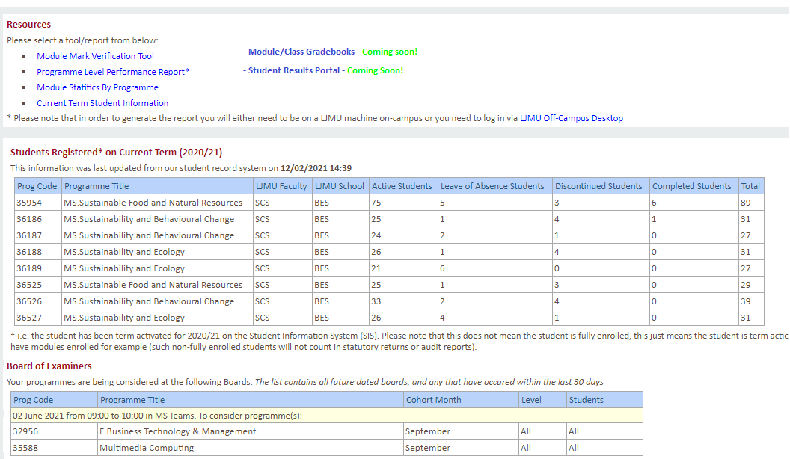
Web hub – Student Results Portal

Slide 10
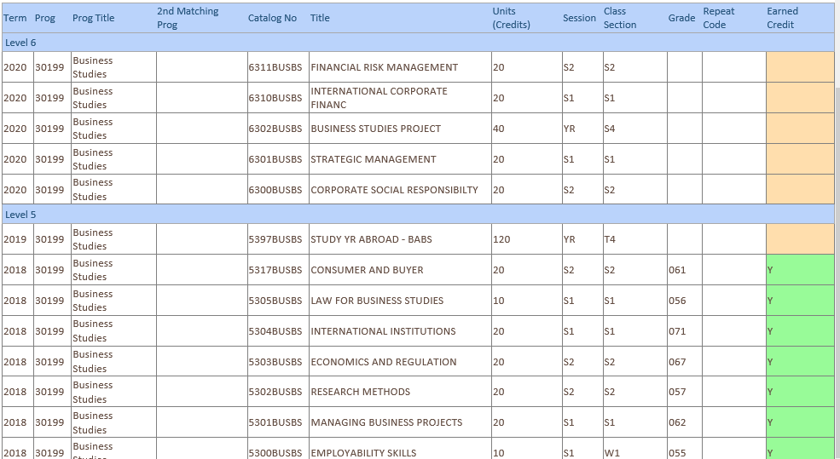
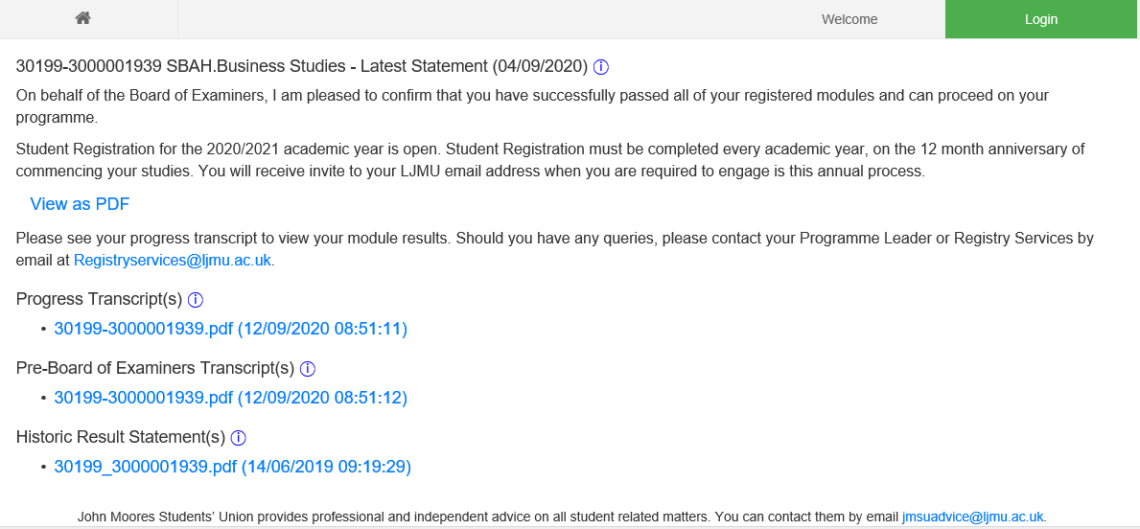
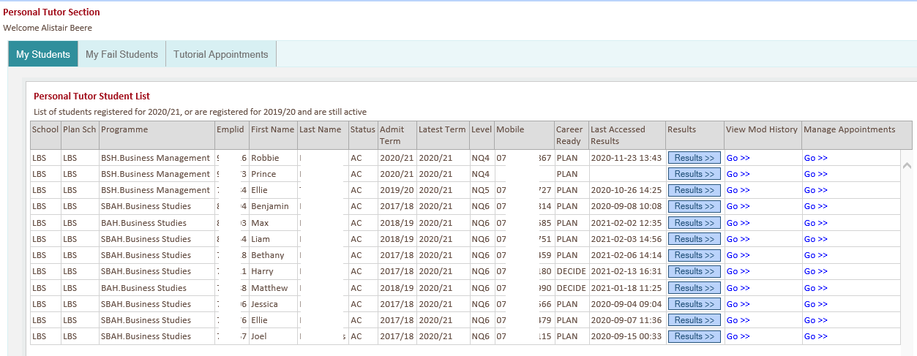
My Results – Staff view of Student Results

Slide 11
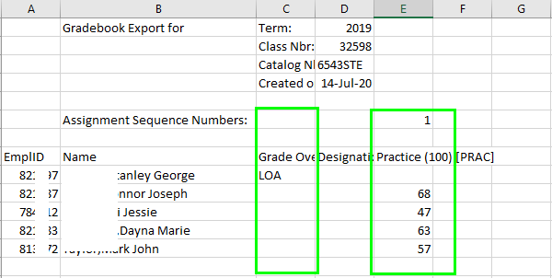
Gradebook Template
Gradebook Templates – provided to and completed by the partner and loaded in to SIS and used for downstream reporting
Gradebook Template – soon to be available direct to partner via Web hub (expected May 2021)

Slide 12
Web Hub - Demonstration

Slide 13
Student Access
Canvas
Electronic Resources
My Results – transcripts and results statements
Virtual Student ID
Library resources*
Office 365*

Slide 14
Questions/Discussions/Feedback

