Slide 1
LJMU’s new curriculum management system
Graham Sherwood, Assistant Academic Registrar – Course information
ljmu.ac.uk

Slide 2
About the project
To replace multiple systems for the production and storage of course information with a “single source of truth”
The university has purchased the Courseloop curriculum management system
This will not only replace Prodcat and Modcat but will also include all the governance processes associated with programme approval and validation within a single system
For LJMU programmes it will also feed into the recruitment pages

Slide 3
Courseloop release schedule
Release 1 – under construction – curriculum data and governance
Test environment release 8th March 2022
UAT May 2022
Final data load July 2022
Release September 2022
Validation change freeze from end of May 2022 to allow migration of up to date programme and module information to the new system
Release 2 – marketer and publisher
Release 3/4 – mapper and reviewer

Slide 4
Plan On a Page
Module | Dec 21 | Jan 22 | Feb 22 | Mar 22 | Apr 22 | May 22 | Jun 22 | July 22 | Q3 22 | Q4 22+
Module | R1 | R1 | R1 | R1 | R1 | R1 | R1 | R1 | R1 R2 | R2 R3
As-is Design Data Mig Build Test Training Live/ELS
Key Italics – plan TBC | Winter Configuration build and test Data migration – data cleanse, ETL (Extract, Transform Load) process iterations to prepare for final data load – dependent on go-live plan Training – develop plan; train the trainer schedule |  |  | Spring Testing – system and user acceptance planning Training – confirm LJMU training plan Complete data migration test process Start planning for Release 2 |  |  | Summer Testing – user acceptance (complete) Training – execute LJMU training plan Complete data migration process (data load) Confirm ready for go-live Go-live of Release 1 (Sept – w/c 5th) Planning & as-is processes for Release 2 LJMU – change freeze (end June to September) |  |  | Winter 22+ R2 design, dev, testing, training, go-live (TBC)
R2
PSD Phase
R2
Live data load
Plan, data analysis, preparation
Test (iterative)
Configuration
R2
Integration
Supplier Test
System
UAT
R2
Planning
Train the Trainers
Ready for go-live?
Train users
1
R1 ELS
Supplier
Joint
LJMU
3rd Party

Slide 5
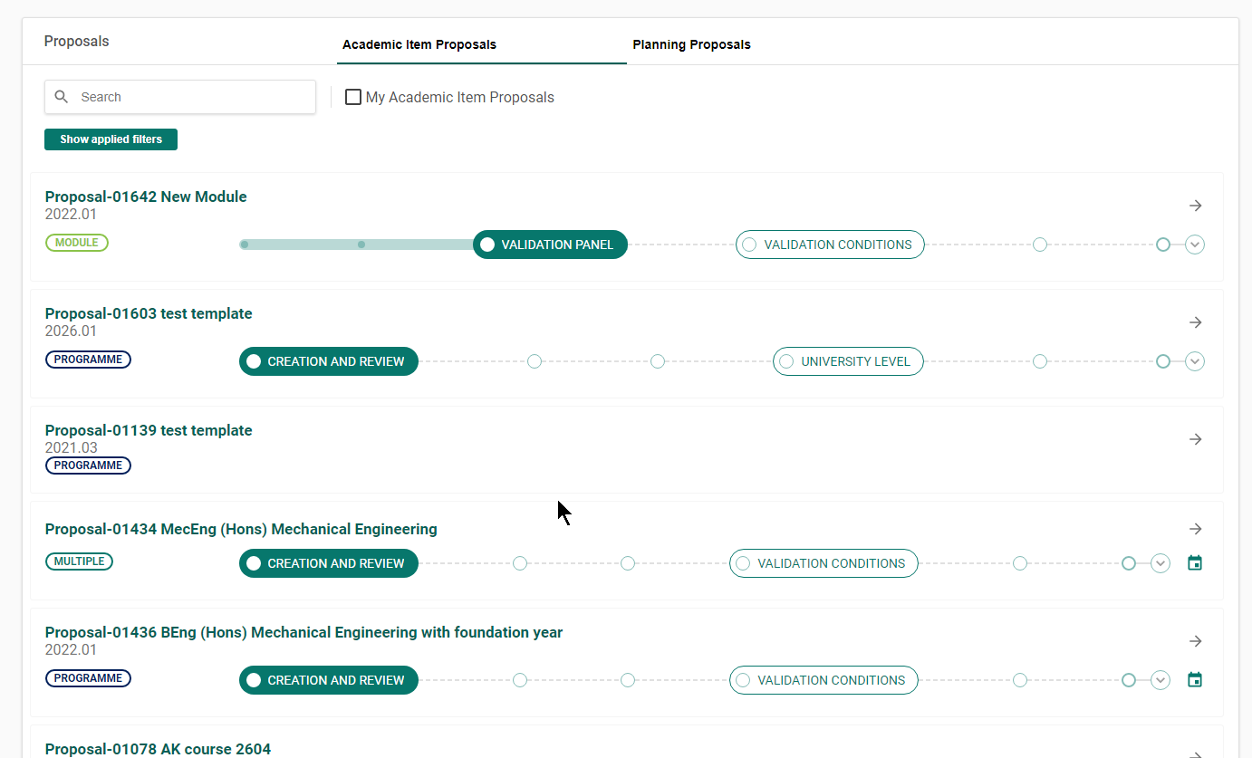

Slide 7
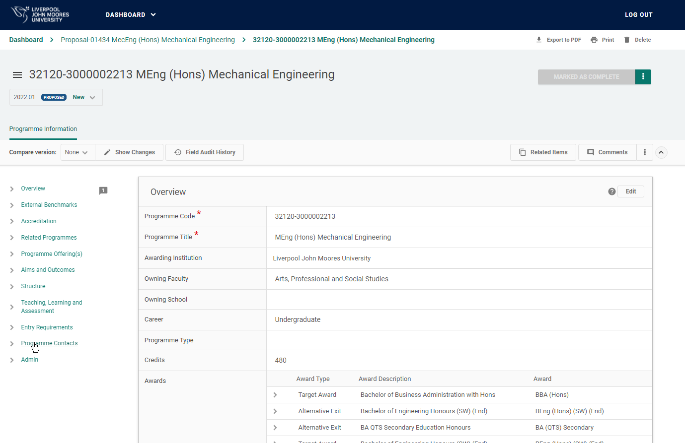

Slide 8
Questions?

