Slide 1


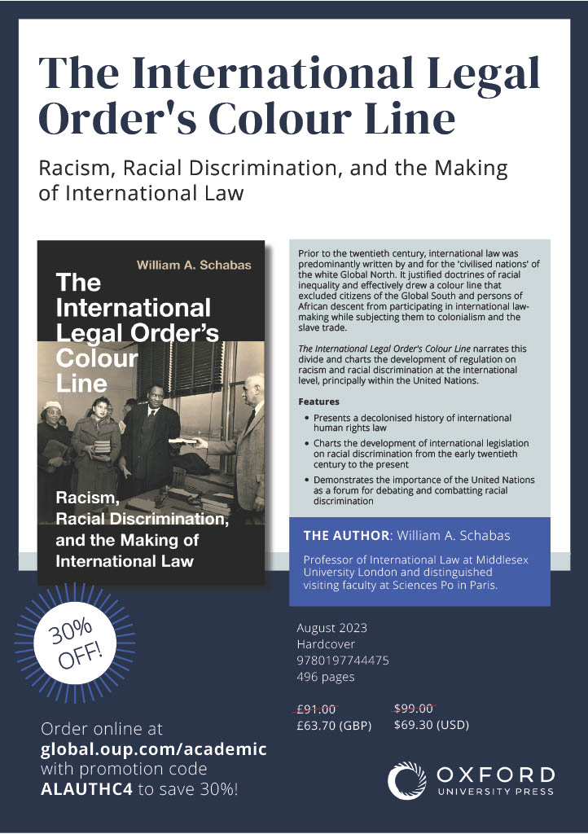
Centre for the Study of Law in Theory and Practice (LTAP)
Annual Lecture on ‘Race, Racial Discrimination and International Law’
Professor William Schabas
Wednesday 14th February 2024
Chair: Professor Gaetano Pentassuglia
Concluding Remarks: Prof Keith George, PVC for Research & Knowledge Exchange

